Slide 1
Attrition ...
Why and When!?
Marty Fromuth
GW Bootcamp
Jun 2020– Jan 2021

Slide 2
Overview
The What
What is the topic?
What are we trying to learn?
What is the data?
The Why
Why did we choose this topic?
Why did we choose this data?
The How
How are we conducting data exploration?
How are we analyzing the data?
How are we storing the data?
How are we displaying our work?
The Results

Slide 3
The What: What is the topic?
Primary Topic: Attrition, aka people leaving a company
Companies want to know when and why employees decide to leave a company, or ’attrit’
Employers maintain information on job performance and compensation
Companies also put out anonymous surveys on satisfaction
A company’s attrition ‘cycle’ can manifest in waves, a consistent trickle, or unpredictable cliffs
Secondary Topic: Attrition in different types or categories of jobs
Most companies have smaller ‘communities’ based on job type or category
STEM, soft-skills and/or HR, and leadership positions may have different priorities
Like overall employees, attrition can manifest in different ways

Slide 4
The What: What are we trying to learn?
Primary questions:
What are they key features that predict attrition?
When and how many employees do we predict will leave?
Do those answers change based on the job category?
Additional insights:
What, if any, correlation is there between different features?
Are there any major differences in features between the job categories?

Slide 5
The What: What is the data?
Synthetic, anonymous HR data representing a tech firm
Multiple fields/features in key areas:
Anonymized employee information (no personal identifiable information)
Job history
Education
Job role and department
Salary
Satisfaction scores
1 primary table with eight reference tables

Slide 6
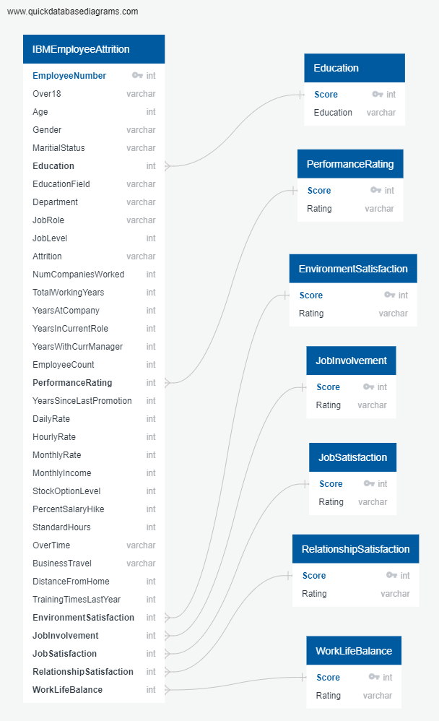
The What: What is the data?
1470 rows / unique employees
Key = ‘EmployeeNumber’
Dropped = ‘EmployeeCount’, ‘StandardHours’, ‘Over18’, ‘MonthlyIncome’, ‘HourlyRate, ‘DailyRate’, ‘Department’, ‘TotalWorkingYears
Created new column = ‘JobCategory’
Leadership
Non-Tech
Tech
Left join main table w/ satisfaction ratings

Slide 7
The What: What is the data?
Combined:
attrition_combined_text (Postgres)
df_attrition_encoded (Python)
Non-Tech:
attrition_nontech_text (Postgres)
df_attrition_nontech_encoded (Python)
Tech:
attrition_tech_text (Postgres)
df_attrition_tech_encoded (Python)
Leadership:
attrition_ldrshp_text (Postgres)
df_attrition_ldrshp_encoded (Python)
Created two main dataframes
Encoded dataframe – used for machine learning model building and inference, and feature analysis
Visualization dataframe – used for the dashboard and to visualize data for the end user
Created tables in Postgres using SQL join & ‘INTO’
Stored these in new Postgres database
Created three sub-dataframes for each of the main dataframes
Leadership
Tech
Non-tech
Build & stored 8 dataframes in total

Slide 8
The Why: Why did we choose this topic?
Companies invest a lot in their employees …
Companies want to build programs to keep employees
Which feature is most common among those who leave → build a program for all employees related to that feature
Do those features change based on the job role → build programs tailored for job roles or job categories
Companies understand attrition is part of life but want to be able to minimize risk of shortage
When will they leave → time recruiting efforts
How many can we expect to leave → drive size of recruiting
Which roles will they leave from → focus recruiting

Slide 9
The Why: Why did we choose this data?
Mixture of attrition results
People who stayed …
People who left …
Includes multiple features in critical categories:
Personal background and information (not Personally Identifiable Info)
History and current employment information and performance
Survey results measuring an employees’ relative satisfaction at a given time
Missing additional features that could be helpful
Time/date of survey
Date of resignation
Multiple survey results to create models for prediction over time

Slide 10
The How: How are we storing the data?
pgAdmin 4.24 with Postgres 12.4
Original tables
IBMEmployeeAttrition
Rating and/or Satisfaction score explanation
New tables created from ETL process in Python
Added ‘JobCategory’ field
Incorporated text fields from satisfaction/rating tables
Created 3x sub-tables for each JobCategory type
Python w/ Jupyter Notebook
SQLAlchemy to upload original table from Postgres; used for ETL process
Export new attrition dataframe to Postgres via SQLalchemy
Maintained encoded dataframes for data exploration, model build & training, and inference assessments

Slide 11
The How: How are we conducting data exploration?
Explore imbalance in the target
Explore correlation between features
Explore distribution of the features
Explore distribution of features to one another

Slide 12
The How: How are we analyzing the data?
Want to predict if someone will attrit or not = classifier
Highly imbalanced target dataset = sampling technique need
Highly variable feature results = needs normalization
Feature data is not evenly distributed = potential weak learners
Large number of variables/features = Random Forest
Rank the importance of features/variables = Random Forest
IDEAL ALGORITHM: Balanced Random Forest Ensemble
TARGET: Attrition (‘Yes’, ‘No’)

Slide 13
The How: How are we analyzing the data?
Strengths of Balanced Random Forest Classifier
Based on bagging ensemble technique for machine learning; helps improve accuracy and robustness of ‘weak learners’
Good for categorical as well as well as continuous variables
Does not require feature scaling; robust to outliers
Incorporates techniques to balance an unbalanced target feature
Robust against overfitting; weak learners trained on different data
Good to rank importance of features in prediction of outcome
Weaknesses of Balanced Random Forest Classifier
Complexity makes it challenging for explainability
Generally requires longer training time

Slide 14
The How: How are we analyzing the data?
Train/Test Split:
70 train // 30 test
Sklearn.model

Slide 15
The How: How are we displaying our work?
Main tool: JavaScript + HTML + CSS

Slide 16
The How: How are we displaying our work?
Bye, Bye, Bye!
Attrition: Why and When?
Selection Bar: Overview // Data Analysis // Machine Learning Model Assessments // Feature Analysis // Conclusions
Overview of the project: The Why
Overview of the project: The How
Overview of the project: The Overall Results
Dataframe:
Drop-down & update with different dataframes (combo, tech, non-tech, leadership)

Slide 17
The How: How are we displaying our work?
Bye, Bye, Bye!
Attrition: Why and When?
Selection Bar: Overview // Data Analysis // Machine Learning Model Assessments // Feature Analysis // Conclusions
Overall Assessments of Data Analysis:
Text
Target Imbalance Display:
Visualization and discussion of imbalance in target in dataframes
Correlation Display:
Visualization of Feature correlation to one another; highlight positive, negatives, and ‘surprises’
Distribution Display:
Visualization w/ drop-downs for each feature AND buttons different analysis based on JobCategory
Comparison Feature Display:
Visualization w/ Comparison of Features

Slide 18
The How: How are we displaying our work?
Bye, Bye, Bye!
Attrition: Why and When?
Selection Bar: Overview // Data Analysis // Machine Learning Model Assessments // Feature Analysis // Conclusions
Overall Assessments of the ML Model:
Text
Machine Learning Assessment Approach:
Text
Graphic Display:
Confusion Matrix, Accuracy, & Imbalance Report w/ buttons for the model used AND the sub-category

Slide 19
The How: How are we displaying our work?
Bye, Bye, Bye!
Attrition: Why and When?
Selection Bar: Overview // Data Analysis // Machine Learning Model Assessments // Feature Analysis // Conclusions
Overall Assessments of the Feature Analysis & Comparison:
Text
Graphic Display:
Comparison of each of the features importance from the classifier

Slide 20
The How: How are we displaying our work?
Bye, Bye, Bye!
Attrition: Why and When?
Selection Bar: Overview // Data Analysis // Machine Learning Model Assessments // Feature Analysis // Conclusions
Overall Conclusions on Our Questions:
Text

Slide 21
The Results: Data Exploration - Overall Findings
Highly imbalanced dataset, especially within leadership dataframe
Target features imbalanced
Feature distribution is highly variable; leadership often older & paid more
Data correlation is relatively even; most correlations expected
Positive:
Age → TotalWorkingYears / MonthlyIncome / JobLevel
MonthlyIncome → YearsAtCompany / TotalWorkingyears
PerformanceRating → PercentSalaryHike
JobLevel → YearsAtCompany / TotalWorkingYears / MonthlyIncome
Nevative: JobCategory → JobLevel / MonthlyIncome / TotalWorkingYears
Unexpected: MaritialStatus / StockOptionLevel (negative)

Slide 22
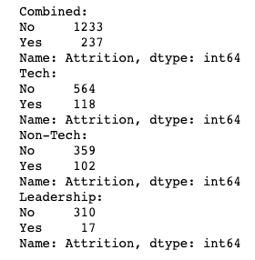
The Results: Data
Explore imbalance in the target
Target data for combined and three sub-categories are all imbalanced
Leadership most imbalanced
Non-tech least imbalanced
Will require sampling technique to correct for imbalance in target data

Slide 23
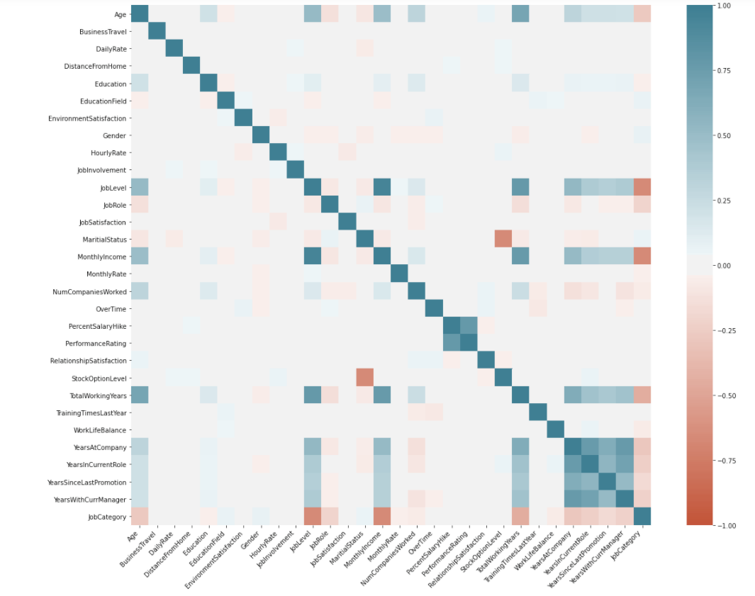
The Results: Data
Multiple positive correlations:
Age: MonthlyIncome / JobLevel / TotalWorkingYears
JobLevel: YearsAtCompany / TotalWorkingYears / MonthlyIncome
MonthlyIncome: YearsAtCompany / TotalWorkingYears
PercentSalaryHike: PerformanceRating
TotalWorkingYears: YearsAtCompany
Multiple negative correlations:
JobLevel: JobCategory
MaritialStatus: StockOptionLevel
MonthlyIncome: JobCategory
TotalWorkingYears: JobCategory
Features representing similar/same information:
HourlyRate / DailyRate / MonthlyRate / MonthlyIncome
Age / TotalWorkingYears

Slide 24
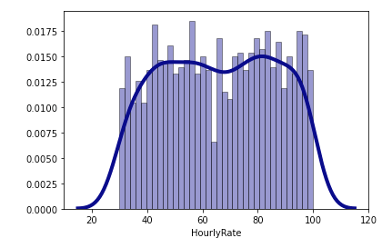
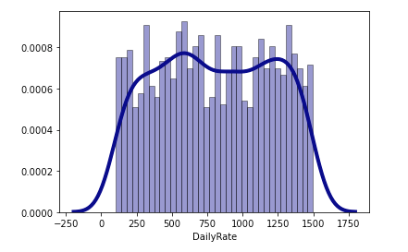
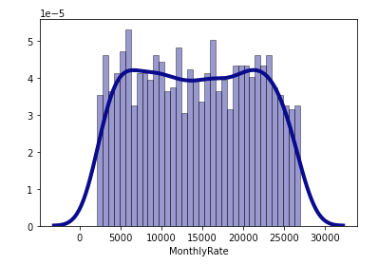
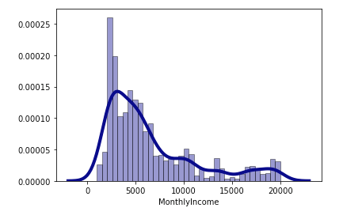
The Results: Data
Four features provide the same info; built new dataframe to assess similarity between data
Assessed distribution to determine which feature would remain, included in model
MonthlyIncome – least normally distributed
HourlyRate, DailyRate – normally distributed
MonthlyRate – most normally distributed
Dropping HourlyRate, DailyRate; MonthlyRate & MonthlyIncome used in model development

Slide 25
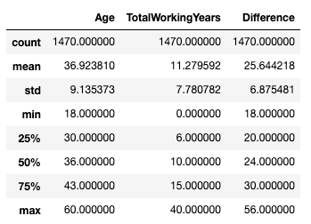
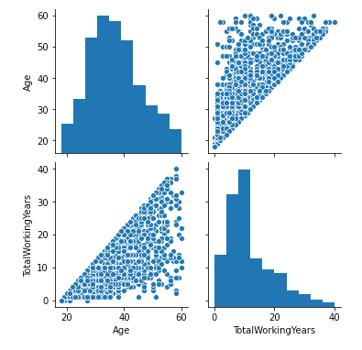
The Results: Data
Age and TotalWorkingYears appear to highlight similar info, but not the same
Used describe and distribution analysis
Both skewed left, but still independent
Maintain both features for the model development and inference

Slide 26
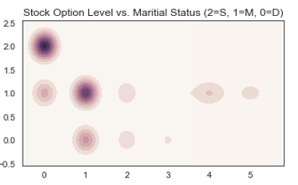
The Results: Data
Single employees tend to have lower stock levels
Married employees appear to have higher levels
Divorced employees fall between the two above
Younger employees are often single vs. married employees; some employees who are divorced get remarried later in life

Slide 27
The Results: Analysis - Overall Findings
Ideal model use is to predict employees who do NOT attrit (‘no’)
Model prediction of employees who attrition (‘yes’) is not robust
F1 scores for categories and overall employees no higher than .51
Largest deficiency in ‘yes’ for attrition is precisions; no higher than .39
Leadership imbalance too large; not able to accurately predict
Poor ability to predict employees who attrit/leave the company
F1 scores no higher than .06 for ‘yes’ to attrition target feature
Model appears to be overfitting for predicting ‘no’ for attrition
Feature importance in attrition does vary based on job category
Tech more sensitive to age, TotalWorkingYears,YearsInCurrentRole; less to YearsWithCurrManager, JobRole
Non-tech more sensitive to StockOptionLevel, NumberofCompaniesWorked, DistanceFromHome; less to YearsWithCurrManager
Leadership more sensitive to YearsSinceLastPromotion, Education, JobLevel, RelationshipSatisfaction, PerformanceRating; less to Age, MonthlyIncome

Slide 28
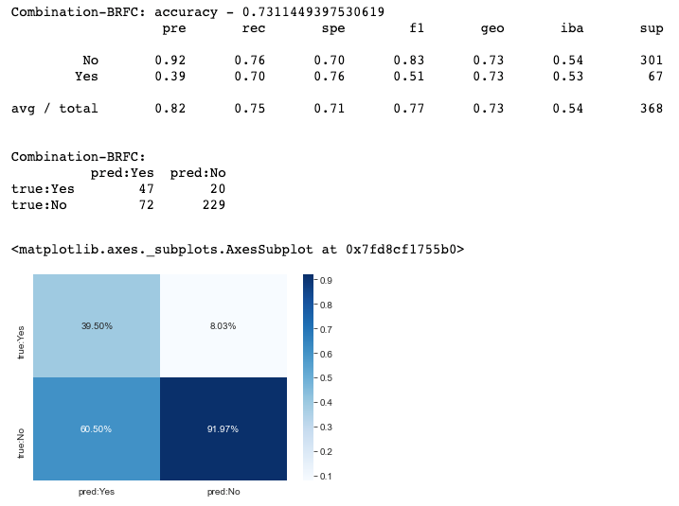
The Results: Analysis - Combo
Precision – Where all the ‘yes/no’s right?
‘Yes’: Worse than a coin toss
‘No’: Fairly accurate
Recall – Did we get all the ‘yes/no’s?
‘Yes’: Fairly accurate
‘No’: Fairly accurate
Overfitting –
‘Yes’: Potentially overfit
‘No’: Not likely overfit
Overall, no better than a coin toss at predicting employees who left, but far better at predicting those who stayed

Slide 29

The Results: Analysis - Tech
Precision – Where all the ‘yes/no’s right?
‘Yes’: Worse than a coin toss
‘No’: Fairly accurate
Recall – Did we get all the ‘yes/no’s?
‘Yes’: Fairly accurate
‘No’: Fairly accurate
Overfitting –
‘Yes’: Potentially overfit
‘No’: Not likely overfit
Overall, worse than a coin toss at predicting employees who left, but far better at predicting those who stayed

Slide 30
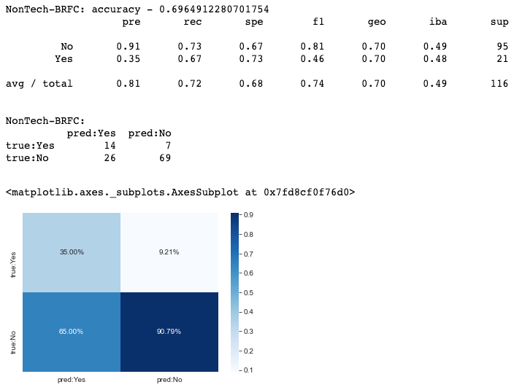
The Results: Analysis - Non-Tech
Precision – Where all the ‘yes/no’s right?
‘Yes’: Worse than a coin toss
‘No’: Fairly accurate
Recall – Did we get all the ‘yes/no’s?
‘Yes’: Fairly accurate
‘No’: Fairly accurate
Overfitting –
‘Yes’: Potentially overfit
‘No’: Not likely overfit
Overall, worse than a coin toss at predicting employees who left, but far better at predicting those who stayed

Slide 31
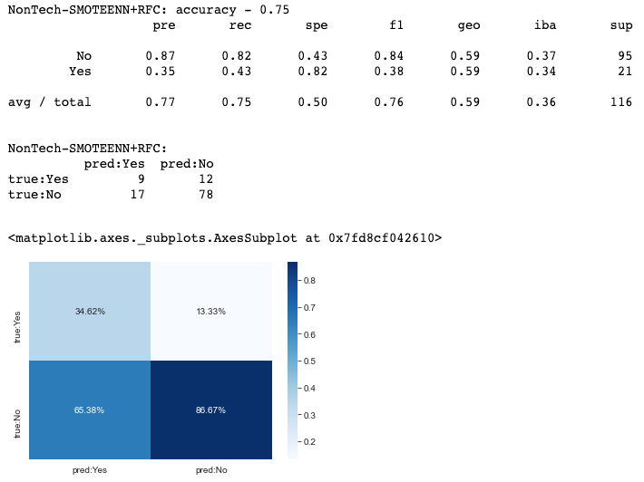
The Results: Analysis - Non-Tech
Precision – Where all the ‘yes/no’s right?
‘Yes’: Worse than a coin toss
‘No’: Fairly accurate
Recall – Did we get all the ‘yes/no’s?
‘Yes’: Fairly accurate
‘No’: Worse than a coin toss
Overfitting –
‘Yes’: Potentially overfit
‘No’: Not likely overfit
Overall, although accuracy is better, the F1 score is no better than a coin toss at predicting people who leave; ability to predict those who stay is less accurate than the BRFC model

Slide 32
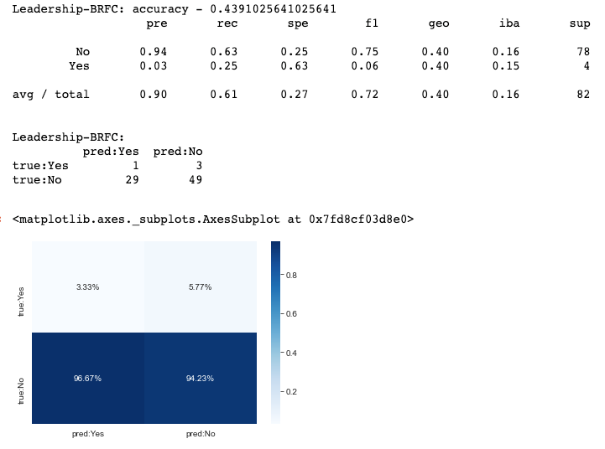
The Results: Analysis - Ldrshp
Precision – Where all the ‘yes/no’s right?
‘Yes’: Completely unreliable
‘No’: Fairly accurate
Recall – Did we get all the ‘yes/no’s?
‘Yes’: Only right ¼ of the time
‘No’: Slightly better than a coin toss
Overfitting –
‘Yes’: Likely overfit
‘No’: Possibly overfit
Overall, completely unable to predict employees who left, but far better at predicting those who stayed, aka did not attrit

Slide 33
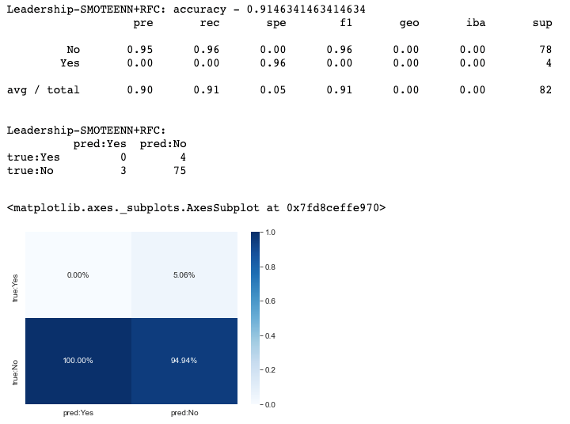
The Results: Analysis - Ldrshp
Precision – Where all the ‘yes/no’s right?
‘Yes’: Completely unreliable
‘No’: Fairly accurate
Recall – Did we get all the ‘yes/no’s?
‘Yes’: Completely unreliable
‘No’: Fairly reliable
Overfitting –
‘Yes’: Likely overfit
‘No’: Unlikely overfit
Overall, far less able to predict employees who left as opposed to BRFC; although predicted employees who stayed better, it is still an unreliable model

Slide 34
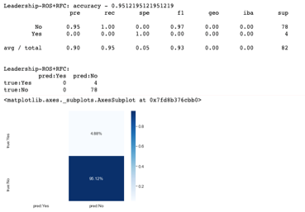
The Results: Analysis - Ldrshp
Precision – Where all the ‘yes/no’s right?
‘Yes’: Completely unreliable
‘No’: Fairly accurate
Recall – Did we get all the ‘yes/no’s?
‘Yes’: Completely unreliable
‘No’: Fairly reliable
Overfitting –
‘Yes’: Likely overfit
‘No’: Unlikely overfit
Overall, far less able to predict employees who left as opposed to BRFC; although predicted employees who stayed better, it is still an unreliable model

Slide 35
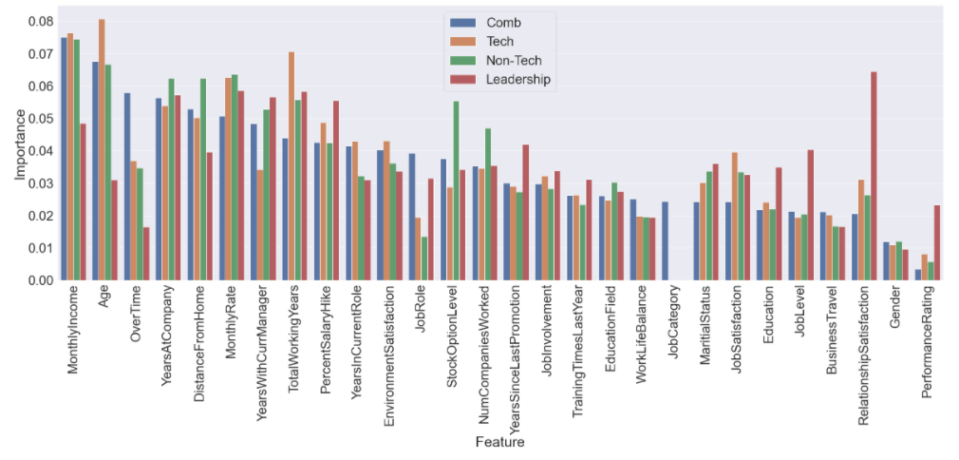
The Results: Analysis - Feature Comparison

Slide 36
Overall Conclusions
Imbalanced targetset, creates problems for predicting attrition
This is especially for the Leadership JobCategory
Much more accurate and appropriate to predict who stays
Feature importance in predicting attrition does vary and therefore can be used to build out targeted mechanisms for retention
Tech roles - more sensitive to time (age, working years, years in role)
Non-Tech roles - more sensitive to stock, experience, and distance from home
Leadership roles - more sensitive to promotion, job level, environment
We saw unique correlations:
Time based features have positive correlation to JobLevel & Income
Positive correlation between job performance and salary hike
Negative correlation between job category, monthly income and working years

